Slide 1
LECTURE 10:PACKETS, FRAMES AND ERROR DETECTION AND CORRECTION
Shared Communication Media
Disadvantage of network using a shared media to interconnect computers is that only one computer can transmit data at a time
Long delays are encountered by the other computers
(see diagram)

Slide 2
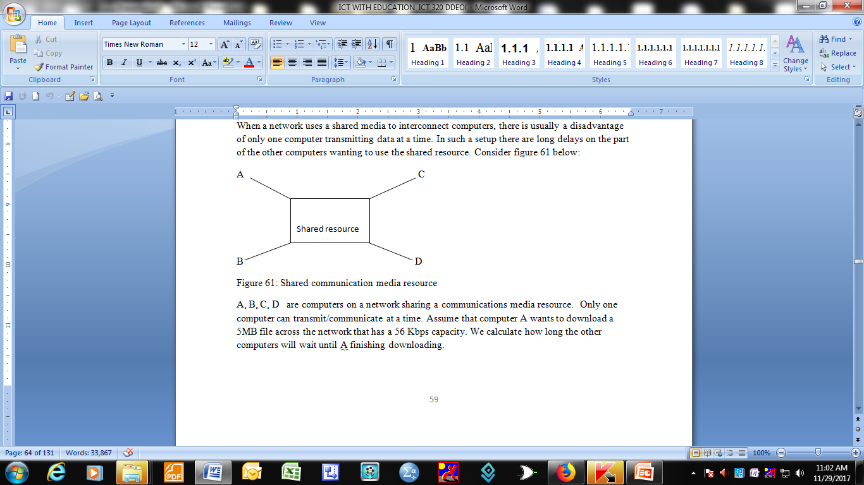
Shared communication medium

Slide 3
A, B, C, D are computers on a network sharing a communications media resource
Only one computer can transmit/communicate at a time
Assume that computer A wants to download a 5MB file across the network that has a 56 Kbps capacity.
We calculate how long the other computers will wait until A finishing downloading.

Slide 4
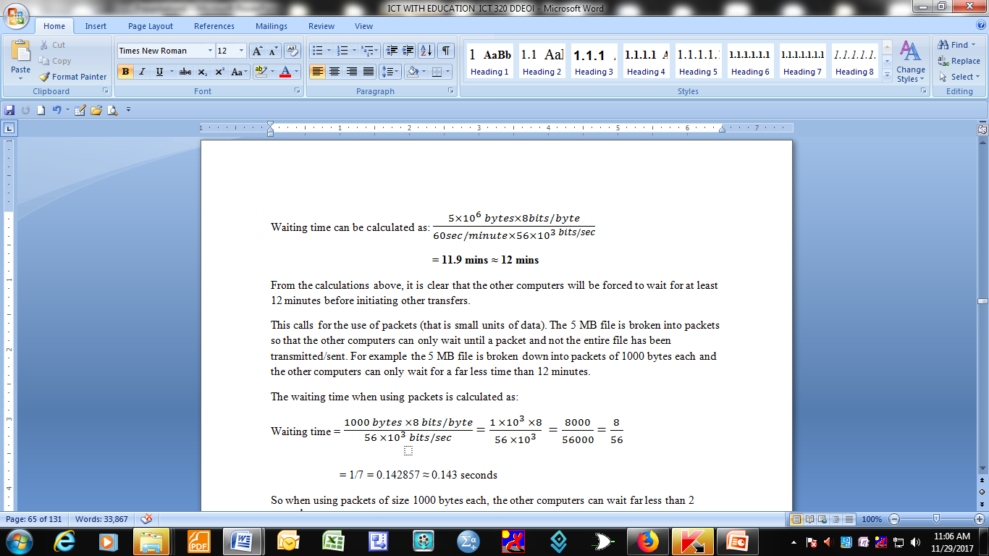
Calculating waiting time

Slide 5
This calls for the use of packets (that is small units of data).
The 5 MB file is broken into packets so that the other computers can only wait until a packet and not the entire file has been transmitted/sent.
For example the 5 MB file is broken down into packets of 1000 bytes each and the other computers can only wait for a far less time than 12 minutes

Slide 6
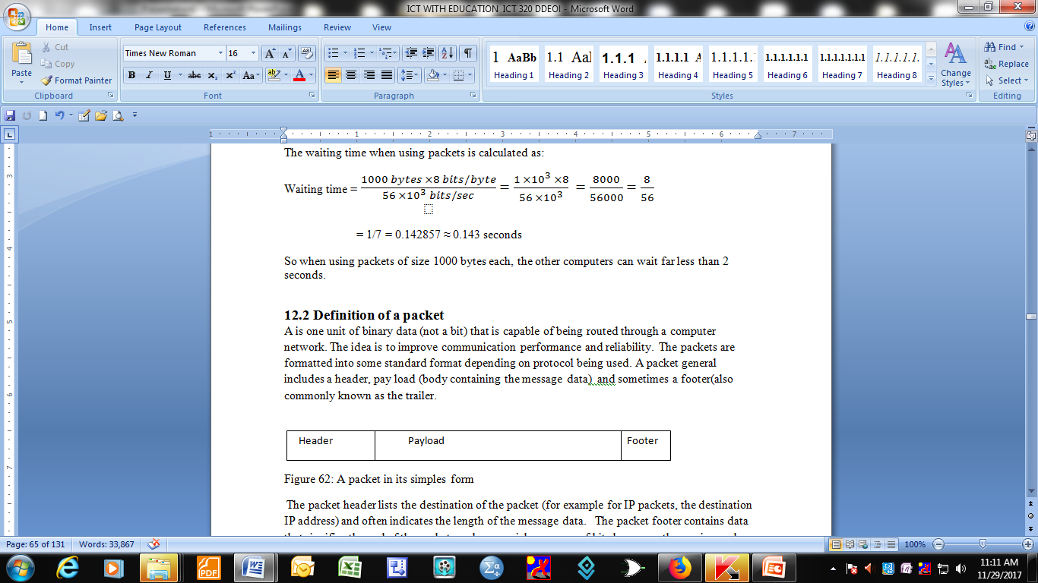
The waiting time when using packets is calculated as:

Slide 7
Definition of a packet
A is one unit of binary data (not a bit) that is capable of being routed through a computer network.
The idea is to improve communication performance and reliability.
The packets are formatted into some standard format depending on protocol being used. A packet general includes a header, pay load (body containing the message data) and sometimes a footer(also commonly known as the trailer.

Slide 8
header payload footer
The packet header lists:
the destination of the packet
often indicates the length of the message data.
The packet footer contains data that signifies the end of the packet such as:
special sequence of bits known as the magic number
Both the header and the footer may contain error checking information

Slide 9
The receiving device is responsible for:
re-assembling individual packets into the original message,
strips off headers and footers and concatenating packets in the correct sequence.

Slide 10
User Datagram Protocol (UDP)
UDP is a simple Open System Interconnection (OSI) transport layer protocol for client/server network applications based on Internet Protocol (IP).
UDP network transport is organized in the form of a datagram.
A datagram comprises one message unit and a UDP header consists of four fields of two bytes each:

Slide 11
UDP contents
Source port number
Destination port number
Datagram size
Checksum

Slide 12
Motivation for using packet switched networks
Coordination: This helps the transmitter and the receiver to determine which data have been received correctly and which one has been received with errors
Resource sharing:- This allows multiple computers to share the network infrastructure
Network fair use:- When using packet switched networks fair use is enforced and each computer can only send one packet at a time.

Slide 13
Frame or hardware frame
A hardware frame denotes a packet of a specific format on a specific hardware technology
In its simplest form, a frame can be made up of a header, data and end of text
Basic format of a hardware frame
header payload eot

Slide 14
The above basic format is used when data is limited to printable ASCII characters. The sending/transmitting computer starts the transmission by sending the start of header (soh) first, then the data (payload) and last the end of text (eot).
The receiving computer interprets and discards the soh, stores the data in the buffer and interprets and discards the eot.
Framing data introduces overheads, for example, start of header(soh) and end of text(eot) take time to transmit but they do not carry any meaningful message to the receiver

Slide 15
There are also transmission problems associated with data framing for example:
Missing end of text(eot) indicates that a sending computer crashes
Missing start of header (soh) indicates that the receiving computer missed the beginning of text(message).This will be interpreted as a bad frame and the message will be discarded.

Slide 16
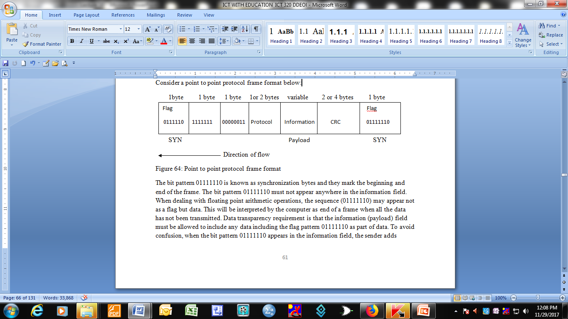
Problems with framing packets(byte and bit stuffing)
Byte stuffing
Consider a point to point protocol frame format below:

Slide 17
Byte stuffing
The bit pattern 01111110 is known as synchronization bytes and they mark the beginning and end of the frame.
The bit pattern 01111110 must not appear anywhere in the information field.
When dealing with floating point arithmetic operations, the sequence (01111110) may appear not as a flag but data.
This will be interpreted by the computer as end of a frame when all the data has not been transmitted.

Slide 18
Data transparency requirement is that the information (payload) field must be allowed to include any data including the flag pattern 01111110 as part of data. To avoid confusion, when the bit pattern 01111110 appears in the information field, the sender adds
(stuffs) an extra 01111110 byte after the occurrence of each 01111110 byte in the information field. Some systems label the stuffed byte 01111110 as ECS (escape).

Slide 19
At the receiver, when the two 0111110 bytes appear in a row, the first byte is discarded and data reception continues. Consider the example in figure 65 below:
(see illustration below)

Slide 20
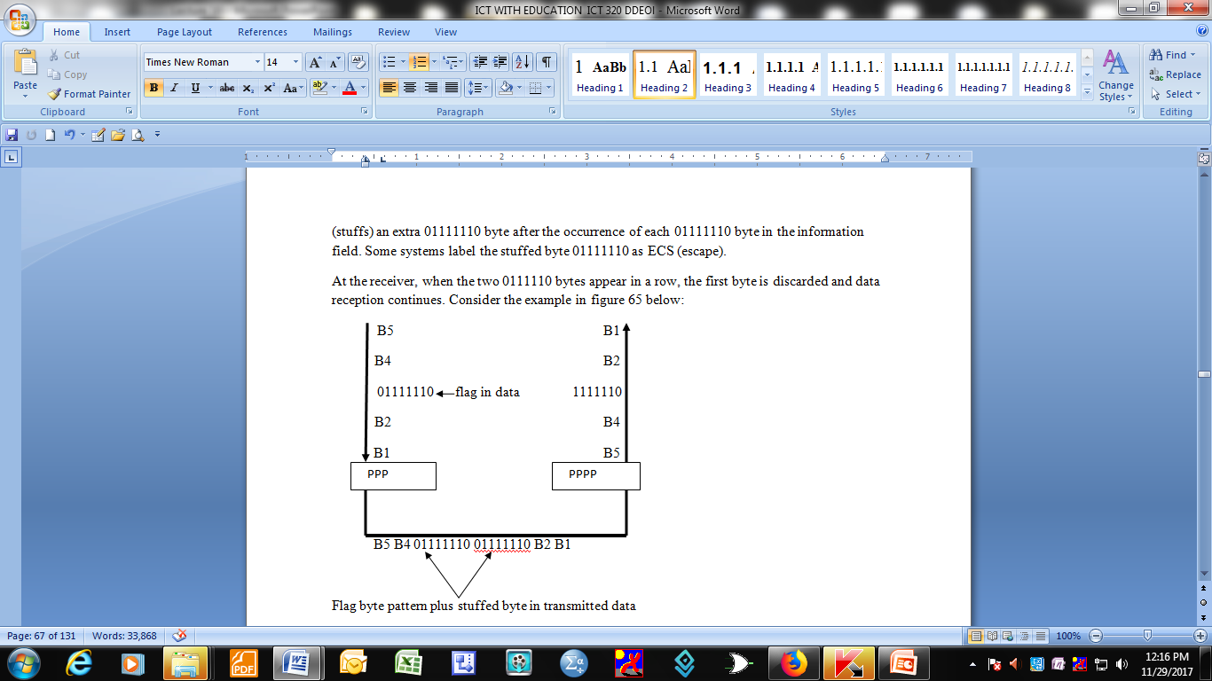
Byte stuffing

Slide 21
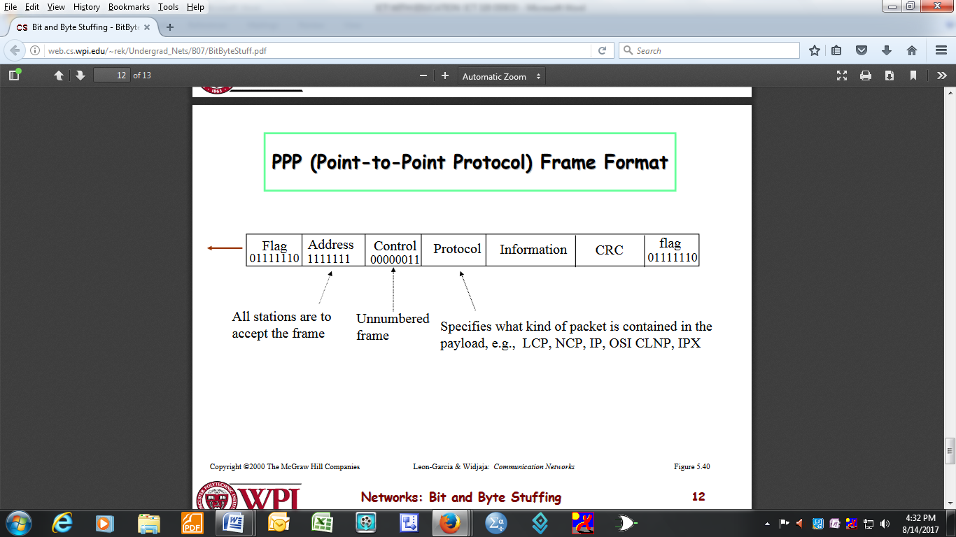
Bit stuffing
Consider an SDLC frame below

Slide 22
Each frame begins and ends with a special bit pattern called a flag byte (01111110). The idea is to avoid the bit stream 01111110 appearing in the information field. During transmission whenever sender data link layer encounters five consecutive ones in the data stream, it automatically stuffs a 0 bit into the outgoing stream. When the receiver sees
five consecutive incoming ones followed by a 0 bit , it automatically removes the stuffed 0 bit before sending the data to the network layer( See example below

Slide 23
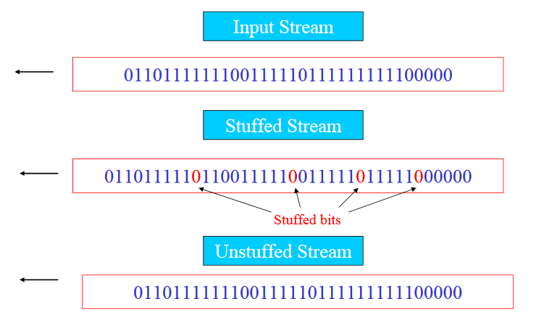
Bit stuffing

